Slide 1
PROJECT
Kiran S
Aryamol A U
Nithin K Shoji
Sreedev D S

Slide 2
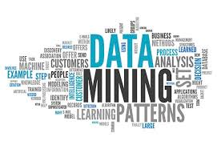
A Web Based Data Mining Framework for Generating User Profiles

Slide 3
ABSTRACT
We present a complete framework and findings in mining Web usage patterns from Web log files of a real Web site that has all the challenging aspects of real-life Web usage mining.
Even though the Web site under study is part of a non-profit organization that does not "sell" any products, it was crucial to understand "who" the users were, "what" they looked at, and "how their interests changed with time," all of which are important questions in Customer Relationship Management (CRM).
Hence, we present an approach for discovering and tracking evolving user profiles.

Slide 4
Existing Systems
The present system contains functionality to receive data as normal keywords

Slide 5
Hardware Requirements
1. Laptops, Pcs etc for accessing the system.
2. Working internet connection.

Slide 6



Software Requirements
1. OS for the system.
2. Web browser.
3.Software run time environments.
4.Apache server.

Slide 7
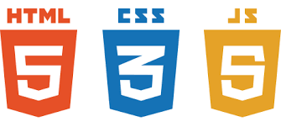

Languages Used
1. HTML
2. CSS
3. Java Script
4. Java

Slide 8



5. PHP
6. Python
7. Database

Slide 9

Libraries and Frameworks
1. Scrapy of python
2. D3.js of Java Script
3.Spark ML of apache

Slide 10

Requirements for Creation
1. Designing Web Crawler.
2. Database maintaining and Organising.
3. Mining required data.
4.Visualising with d3.js

Slide 11
Advantages
1. Faster access to data.
2.Well organisable and maintainable.
3.Safe and Secure.
4. Reliable.
5. All data concentrated at one place.
6.Donot require to open multiple tags.

Slide 12
Disadvantages
1. Chances of alterations due to spamming.
2. Duplicated names can cause problems.
3. Requires accurate names for mining.

Slide 13
Process Flow
Crawling and Mining
Database
Visualisation

Slide 14
Conclusion
Creating a fast and reliable way for mining data and generating user profiles.

Slide 15
Thank you

